Slide 1
Counting Elements and Atoms
Presented by Kesler Science
Notes:
Created by Kesler Science – More 5E lessons at KeslerScience.com

Slide 2
Essential Questions:
How are chemical formulas used to identify substances?
How do chemical formulas determine the number of atoms of each element using subscripts, coefficients, and parenthesis?

Slide 3
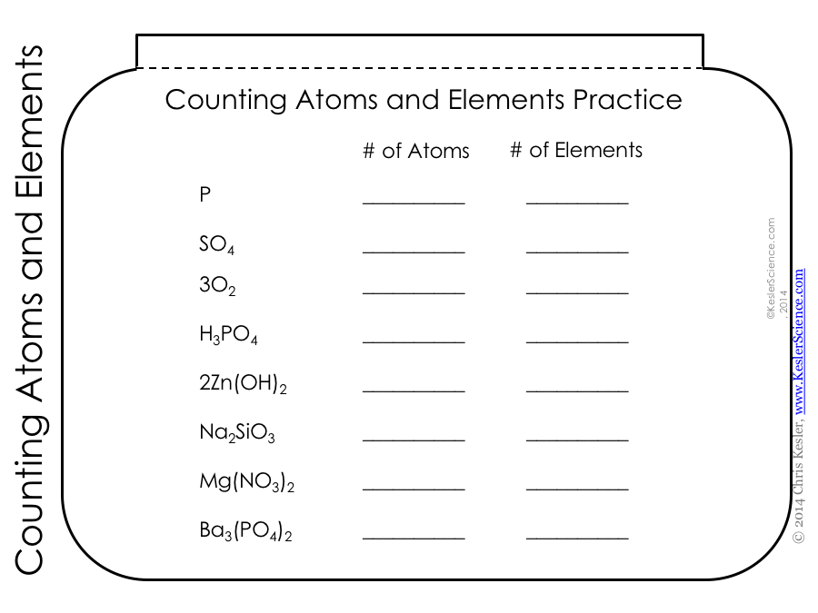
Quick Action – INB Template
Directions for INB Template
Cut out the three INB pages for Counting Atoms and Elements.
Paste this whole page into your notebook. (It will be the last page of a 3 page flipbook.)
This will be page 3.

Slide 4
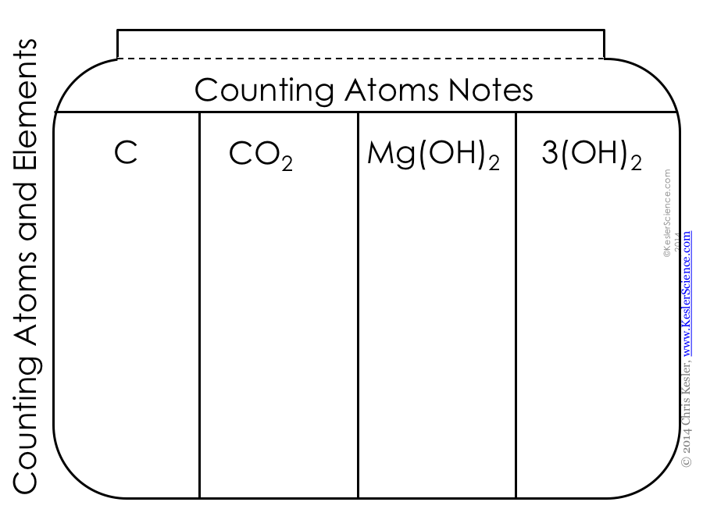
Quick Action – INB Template
Directions for INB Template
Page 2
Paste only the tab on top of page 3 that says “Counting Elements and Atoms and Elements Practice.”

Slide 5
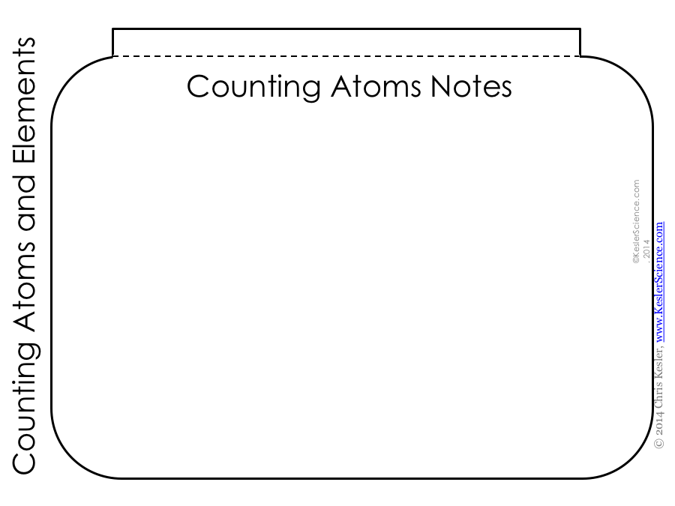
Quick Action – INB Template
Directions for INB Template
Page 1
Paste only the tab on top of page 2 that says “Counting Elements and Atoms and Elements Practice.”

Slide 6
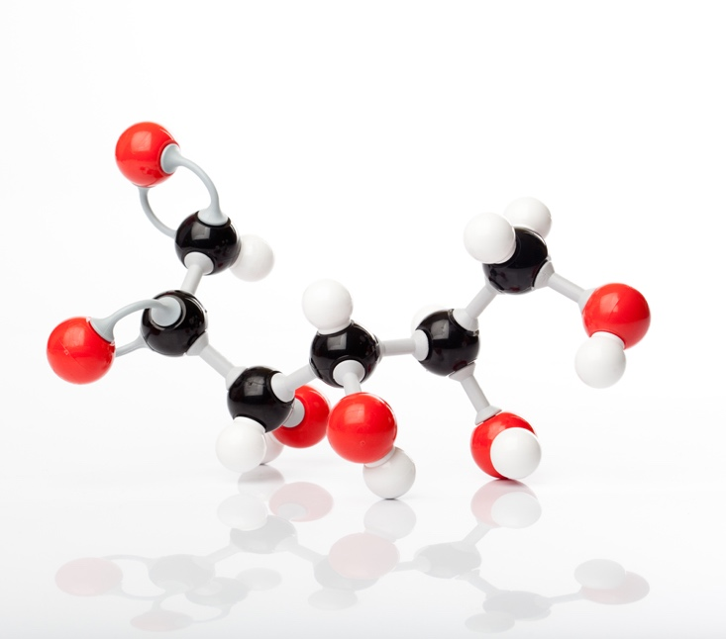
Counting Elements and Atoms
Glucose
Elements
A chemical that cannot be broken down into another substance
Each unique capital letter represents a different element.
How many elements are in glucose?
C₆H₁₂O₆
3 Elements

Slide 7
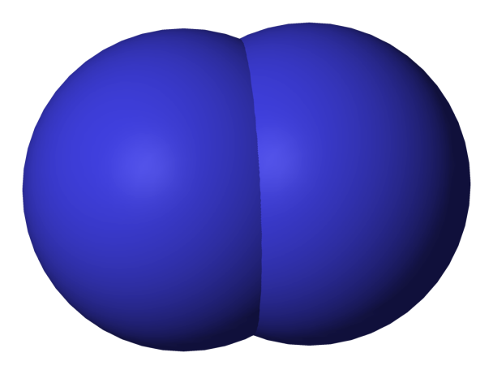
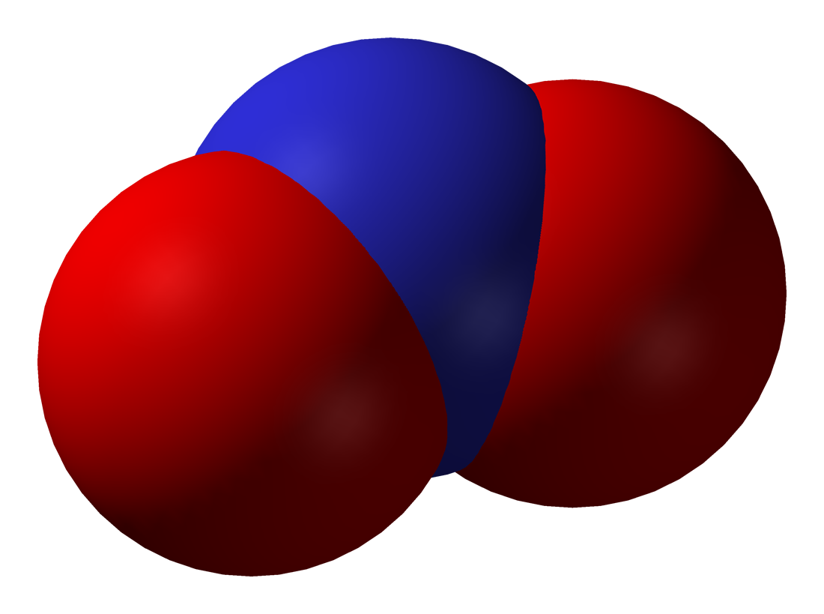
Counting Elements and Atoms
Atoms
The smallest part of a chemical element
Found on the Periodic Table
Combining atoms creates molecules.
Molecule of an element (same kind of atoms)
Molecule of an compound (different kind of atoms)

Slide 8
Counting Elements and Atoms
Formula for Molecules
An expression which states the number and type of atoms present in a molecule of a substance.
H₂ tells you there are 2 atoms of hydrogen.
H₂O tells you there are 2 atoms of hydrogen and 1 atom of oxygen.
Molecule of an element (same kind of atoms)
H₂
Molecule of an compound (different kind of atoms)
H₂O

Slide 9
Counting Elements and Atoms
Adding the Subscripts
How can you tell there is only one atom of oxygen in H₂O?
Subscripts
The small numbers after the element’s name
No subscript means there is only one atom present. (The one is not needed.)
Molecule of an element (same kind of atoms)
H₂
Molecule of an compound (different kind of atoms)
H₂O

Slide 10
Quick Action – Counting Elements and Atoms
Let’s practice counting.
Count the number of atoms in each formula using the subscript.
Check your answer with a partner.
CuSO₄ C₂H₄O₂
NH₃ CaO₄
C₄H₁₀ MgBr₂

Slide 11
Counting Elements and Atoms
Subscripts + Coefficients
Big number at the beginning of this formula is a coefficient
Involved in counting atoms
Represents the number of molecules for that compound
Important when balancing equations
2H₂SO₄
Sulfuric Acid

Slide 12
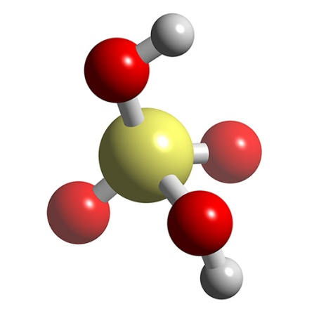
Counting Elements and Atoms
Calculating the number of atoms including the subscripts and coefficients.
This formula means there are 2 H₂SO₄ molecules.
We know in each molecule there are:
2 hydrogens
1 sulfur
4 oxygens
2H₂SO₄
Sulfuric Acid
To find the total number of atoms, multiply each of these atoms by 2.
Total atoms for this formula = 14

Slide 13
Quick Action – Counting Elements and Atoms
Let’s practice counting.
Count the total number of atoms for each element in the compounds below.
Check your answer with a partner.
6CuSO₄ 2C₂H₄O₂
3NH₃ 5CaO₄
4C₄H₁₀ 4MgBr₂

Slide 14
Counting Elements and Atoms
Calculating the number of atoms including the parenthesis.
This formula means aluminum is bonded to a molecule of sulfur and oxygen.
We know in this molecule there are:
2 aluminums
3 sulfurs
12 oxygens
Al₂(SO₄)₃
Aluminum sulfate
To find the total number of atoms, multiply 3 by each element in the parenthesis.
Total atoms for this formula = 17

Slide 15
Quick Action – Counting Elements and Atoms
Let’s practice counting.
Count the total number of atoms in each compound using
subscripts, coefficients, and parentheses.
Check your answer with a partner.
Ba(NO₃)₃ Co(NO₃)₂
Fe(OH)₂ (NH₄)₂SO₄
Al₂(SO₄)₃ Al₂(CO₃)₃

Slide 16
Counting Elements and Atoms
Calculating the number of atoms including subscripts, coefficients, and parenthesis.
This formula means there are 2 molecules of Al₂(SO₄)_{3.}
We know in this molecule there are:
4 aluminums
6 sulfurs
24 oxygens
2Al₂(SO₄)₃
Aluminum sulfate
To find the total number of atoms, multiply the 3 by each element in the parenthesis. Then multiply each element by 2.
Total atoms for this formula = 34

Slide 17
Quick Action – Counting Elements and Atoms
Let’s practice counting.
Count the number of atoms in each formula using
subscripts, coefficients, and parenthesis.
Check your answer with a partner.
2Ba(NO₃)₃ 4Co(NO₃)₂
3Fe(OH)₂ 2(NH₄)₂SO₄
2Al₂(SO₄)₃ 3Al₂(CO₃)₃

Slide 18
Check for Understanding
Can you…
Recognize that chemical formulas are used to identify substances?
Recognize that chemical formulas determine the number of atoms of each element in chemical formulas containing subscripts, coefficients, and parenthesis?
Notes:
Clear up any confusion and answer questions.

