Slide 1
Welcome to 8th Grade Physical Science
Mrs. Amy Macchia
Please use the contact form on my website to email me.

Slide 2
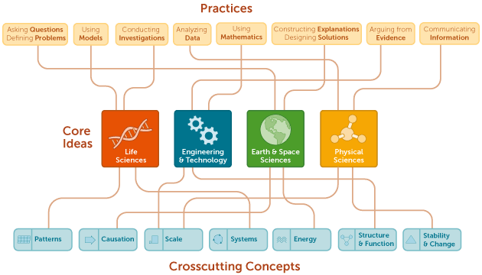
NGSS Next Generation Science Standards

Slide 3
8th Grade Science Topics
Scientific Process, Safety, Metric Tools, and Measurement
Structures and Properties of Matter
Energy
Atomic Structure and
Periodic Table
Chemical Reactions

Slide 4
8th Grade Science Topics
Forces and Interactions
Waves and Electromagnetic Spectrum
Engineering and Design

Slide 5
Grading
Grades will be posted on the parent portal
Grades will be based on:
Tests
Quizzes
Labs
Alternative assignments
Homework
Projects
In-class activities
Please take note of the following notations on the parent portal:
Absent – indicated an assignment was not handed in or completed due to absence (5 days to make up)
Incomplete
Late – indicates assignment was handed in late
Exempt – student is not impacted by grade, positively or negatively.
Blank or no score – assignment has not yet been graded.

Slide 6
Engineering and Design
Science and Music Long Term Project
The Great Energy Debate
Rube Goldberg Design Challenge
Big Freeze
Periodic Table Project
Food Label Analysis
Roller Coaster Design Project

Slide 7
Additional Help
Available before and after school for extra help, catching up from an absence, or general questions.
Students can report to the main office in the morning to request help.

